Slide 1
Introduction to Git
Christian Wollmann, 10.09.2023

Slide 2
GitHub.com vs. GitHub-Desktop
Basis: Git as a decentralized version control system
Utility used by command center
Decentralized version control system
Tracking changes
GitHub-Desktop
GitHub.com
Host for Git-projects
Cloud based repository
Collaborative work
https://github.com/signup?ref_cta=Sign+up&ref_loc=header+logged+out&ref_page=%2F&source=header-home
Graphical user interface (GUI)
Dektop application
Access to repositories
https://desktop.github.com/

Slide 3
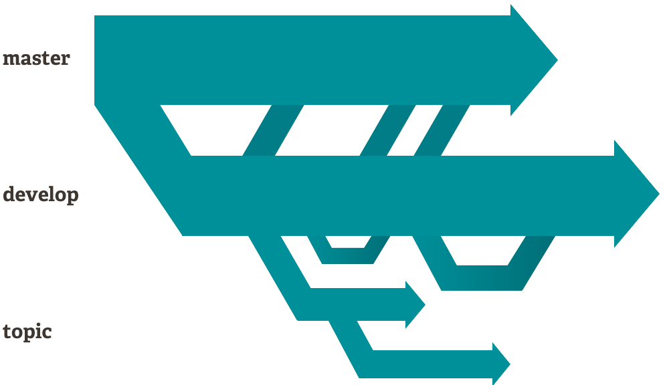
Basics and Concepts: Branching-Modell
Existing projects are defined as repositories.
A repository is composed of multiple branches.
The branching model is hierarchically structured, forming a pyramid.e
Cloning the Master branch → Sub-branch
Master branch = final project
Sub-branch = Sandbox

Slide 4
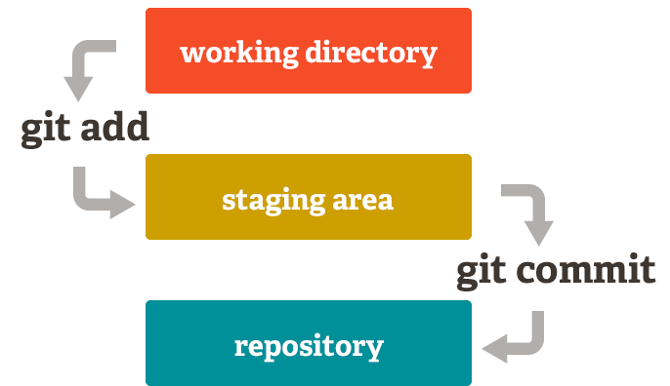
Basics and Concepts: Staging Area
Changes are not immediately adopted.
The Staging Area is like a blank canvas
This process forms a cycle

Slide 5
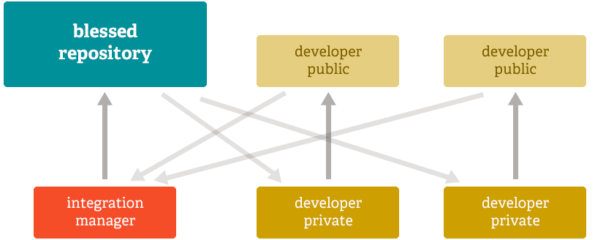
Basics and Concepts: Merging
Repository is split into branches with subtasks
Sub-branches are finalized
Ultimately, merging of finalized subtasks

